Slide 1
Poland conventional long form: Republic of Poland
total: 312,685 sq km
land: 304,255 sq km
water: 8,430 sq km
country comparison to the world: 71
Poland joined NATO in 1999 and the EU in 2004

Slide 2
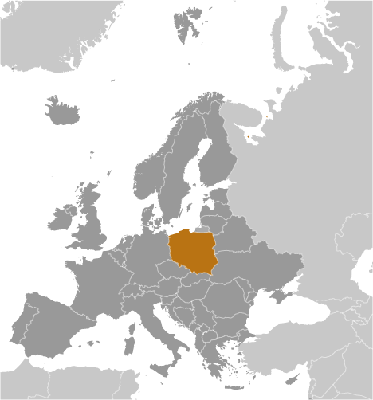

Slide 3
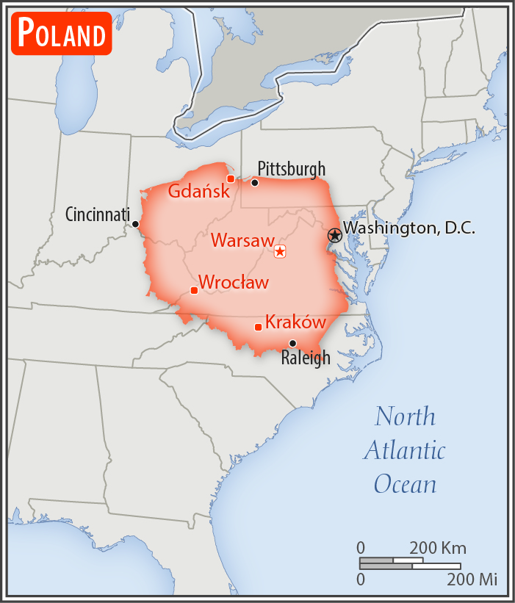

Slide 4
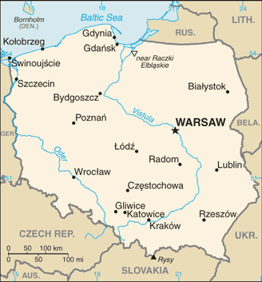

Slide 5
Labor turmoil in 1980 led to the formation of the independent trade union "Solidarity„
Free elections in 1989 and 1990 won Solidarity control of the parliament and the presidency, bringing the communist era to a close.
A "shock therapy" program during the early 1990s enabled the country to transform its economy into one of the most robust in Central Europe.

Slide 6
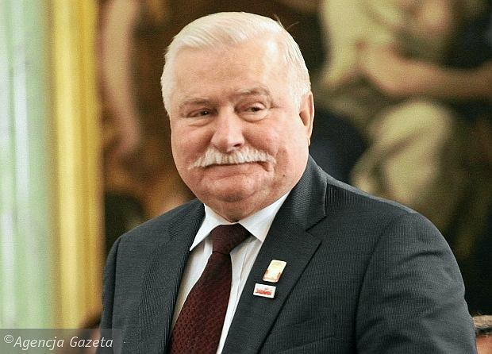

Slide 7
Population - 38 480 000
Ethnic groups: Polish 96.9%, Silesian 1.1%, German 0.2%, Ukrainian 0.1%, other and unspecified 1.7%
Age structure:
0-14 years: 14.76% (male 2,919,353/female 2,757,923)
15-24 years: 10.7% (male 2,113,358/female 2,003,033)
25-54 years: 43.48% (male 8,447,418/female 8,283,757)
55-64 years: 14.21% (male 2,586,097/female 2,880,031)
65 years and over: 16.86% (male 2,560,847/female 3,924,452)

Slide 8
Median age
total: 40.7 years
male: 39 years
female: 42.4 years (2017 est.)
country comparison to the world: 47

Slide 9
Population growth rate
-0.13% (2017)
country comparison to the world: 206
9.5 births/1,000 population (country comparison to the world: 202)
10.4 deaths/1,000 population

Slide 10
Infant mortality rate
total: 4.4 deaths/1,000 live births (2017)
country comparison to the world: 182

Slide 11
Life expectancy at birth
total population: 77.8 years
male: 73.9 years
female: 81.8 years (2017)
country comparison to the world: 67

Slide 12
Total fertility rate:
1.35 children born/woman (2017)

Slide 13
Health expenditures
4.2 – 4.4% of GDP (2014)
country comparison to the world: 97
We demand at least 6.8%
2.3 physicians/1,000 population (2015)
135000 active doctors, 90000 specialists
6.5 beds/1,000 population (2013)

Slide 14
Remuneration
Average gross monthly - €1100
Average for junior doctors - €490 - €920
Taxes: about 30%
After last strike: €1570 (but must work only in one place)

Slide 15
GDP (official exchange rate):
$524.9 billion (2017 est.)
GDP - per capita (PPP):
$29,500 (2017 est.)
$28,700 (2016 est.)
$27,600 (2015 est.)
note: data are in 2017 dollars

Slide 16
Organizations
Medical Chamber (all docs must be a member)
Supreme and 24 regional
Doctors’ Trade Union
Other Unions

Slide 17
Medical chamber - tasks
Granting and authorisation to practice
Supervising the profession
Setting the principles of professional ethics
Representing and protecting dignity and integrity
Taking actions aimed at improving the conditio of work and salaries
Cooperation with other organisation for doctors

