Slide 1
SLOVAKIA
TRADE UNION OF PHYSICIANS (LOZ)

Slide 2
Basic information about the LOZ
Year of establishment: 27 April 1996
Chairman of the LOZ: MUDr. Peter Visolajský
Trade Union of Physicians includes app. 50 % of physicians in all faculty hospitals in Slovakia, which are pillars of Slovak health care sector.

Slide 3
Basic information about the LOZ II
Mission and vision of the LOZ
Improve the position of physicians and health care professionals in the Slovak Republic
Protect and defend their economic and social rights in legal manner
Coordinate activities of LOZ branches
Cooperate with trade unions in surrounding countries

Slide 4
Accomplishments of the LOZ
Activities that led to stopping the privatization of state hospitals
Increase of salaries of physicians and annual salary increase depending on the salary growth in the national economy
Initiation of introduction of the DRG
Partial improvement of adherence of the Labour Code and the decree concerning minimum material and personnel requirements in all health care facilities in Slovakia
Physicians have become protected persons by law

Slide 5
Other activities of the LOZ
Ďakujem, úplatky neberiem (Thank you, I do not take bribes) initiative - public declaration of physicians on non-accepting bribes (with the recognition of the study of the European Union on corruption)
Filing to the European Commission concerning financial group PENTA (it own a health insurance company – 2nd biggest one, hospitals, clinics, laboratories, pharmacies, drugs manufacturing plant, it has significant influence on the ministry of health)
Suspension of the buildup of a Central Slovak Hospital in the form of PPP
Pointing out at numerous corruption cases in the health care sector and conclusion of consequences

Slide 6
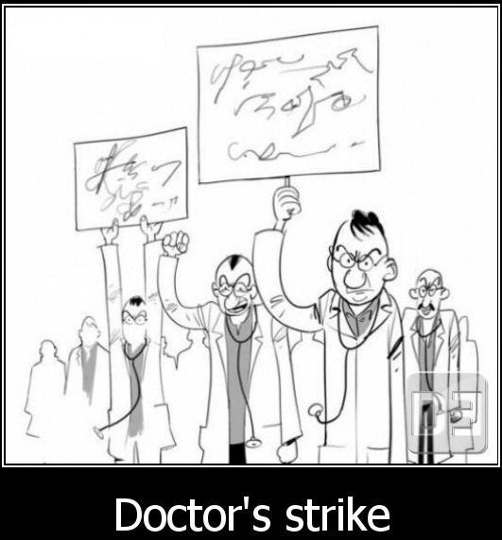
STRIKE

Slide 7
“Strike” and resignations of physicians in 2011
(based on mass resignation letters of 29% hospital physicians in 2011
thanks to cooperation with Czech Trade Union of Physicians)
Achieved goals:
Suspension of privatisation of state hospitals
Basic salaries of physicians (before that, app. EUR 800):
- EUR 2,097 certified : 2.3 multiple of the average salary in the national economy in 2016
- EUR 1,140 non-certified: 1.25 multiple of the average salary in the national economy in 2016
Initiation of introduction of the DRG
Improvement of adherence to the Labour Code and the decree concerning minimum material and personnel requirements

Slide 8
Resignations from shifts in 2017
Reason:
The Minister of Health wanted to freeze salary coefficients of physicians
Procedure:
- Resignations from shifts in many university hospitals (possible threat to operability of hospitals)
- Slogan – “We want to help save money and therefore we will stop working in shifts”
Accomplished goal:
- the Minister of Health admitted it made no sense to make the situation even worse
- the salary automaton did not change, the Ministry guaranteed money for salaries to hospitals

Slide 9
Migration of physicians from Slovakia
Slovak physicians moving our of the country is another principle issue of Slovak health care sector. The table provides a general overview of numbers of Slovak physicians in health care systems in the most popular “destinations”.
Total number of physicians abroad: | App. 4,211 | Last monitored year
Czech Republic | 1,671 (2010) | 2,035 (2017)
Austria | 70 (2010) | 242 (2017)
Germany | 632 (2010) | 1,185 (2017)

Slide 10
Migration of physicians from Slovakia
6.8% of physicians are foreigners
Physicians coming to Slovakia are mostly from the Ukraine and some from Czechia
Physician’s salary in the Ukraine is € 300 (average salary is € 200), certified € 150, the salary difference is almost publicly compensated by bribes
There are no conditions of work set for foreign physicians in Slovakia (differentiation examinations, necessity to speak the language)
Slovakia is often just a changing station, until they receive the required certificate
If laws were kept, the current physicians headcount would be app. 30% under the requirement

Slide 11
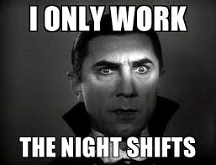
Working time of physicians

Slide 12
Working time of physicians
University hospitals:
Max 56 hours a week
Max 400 hours of overtime per year (the limit is exceeded by falsifying reports), such high limit is only set for health care employees
The number of emergency service hours is not limited
24-hour shifts (12hrs regular shift, 12hrs emergency), somewhere also 12-hour shifts/emergency

Slide 13
Working time of physicians
II
Private hospitals:
max “x” hours per week
Max 400 hours of overtime per year (the limit is exceeded by falsifying emergency service reports and part-time jobs)
Unlimited number of hours for stand-by (on the phone)
Weekend, 32-, 24-, 12-hour shifts (depending on the hospital management)

Slide 14
Number of patients per physician
Day shift:
App. 17 patients per physician, including ICU
App. 4 patients per physician – anesthesiology ICU
App. 5 patients per physician – post-neonatal ICU
Night shift:
App. max. 100 patients per physician

Slide 15
“Rights” of physicians in Slovakia
In the case of legal resignations of physicians, unless the government makes agreement with physicians during the 2-month notice period, the government can declare the state of emergency and thus impose the work obligation on physicians.
At the time of state of emergency (also resignation letters of physicians), the Ministry of Health (responsible for the failure of negotiations), has the right of decide that the work obligation was breached and
Impose a fine on health care employees (it is 10 times higher than for other citizens)
Arbitrarily remove a physician’s license– without decision of a court, chamber, trade unions.

Slide 16
“Rights” of physicians in Slovakia
II
Impose a fine on health care employees (it is 10 times higher than for other citizens)
Arbitrarily remove a physician’s license– without decision of a court, chamber, trade unions
The sentence for failure to keep emergency terms is up to 5 imprisonment
Physicians are the only group of employees who must pay taxes on non-financial grants (e.g. payment of the congress fee by a pharmaceutical company)

Slide 17
Future plans of the LOZ
Salary differentiation – better salaries for better physicians, salary increase depending on the number of years worked
Think – Tank LOZ
Review of the activity of the Ministry of Health and financial groups in the health care sector
Pressure to increase efficiency in the health care sector, build state endpoint hospitals

Slide 18
THANK YOU FOR YOUR ATTENTION

